Slide 1

Predicting Academic Outcomes Using Machine Learning
Umar Abbasi et al. — study using the Open University Learning Analytics Dataset (OULAD) to predict student success from demographics, VLE engagement, and assessments. Random Forest achieved 98.3% accuracy.

Slide 2

Research Objective
Goal
Data Source
Develop interpretable ML models to identify at-risk students early and enable targeted interventions.
OULAD — 32,593 student records with demographics, VLE interactions, assessments.
Impact
Actionable insights for personalized tutoring, adaptive learning paths, and reduced dropout rates.

Slide 3

Key Features & Preprocessing
Missing records omitted to preserve behavioral patterns. Categorical variables one-hot encoded; features scaled with Min-Max. Core inputs:
Demographics: age band, prior education, IMD band
Engagement: VLE logins, resource access, assignment submissions
Outcomes: final results (distinction, pass, withdrawal, fail)

Slide 4


Feature Engineering & Selection
Behavioral Features
RFE Selection
Derived metrics: login frequency per week and assessment consistency to capture engagement dynamics.
Recursive Feature Elimination prioritized influential predictors (prior education, IMD band) for interpretability and efficiency.

Slide 5

Models Chosen
Decision Tree
Interpretable baseline providing clear rule-based insights.
Gradient Boosting
Iterative error reduction for complex structured data.
Random Forest
Robust ensemble chosen for superior accuracy and reduced overfitting.

Slide 6
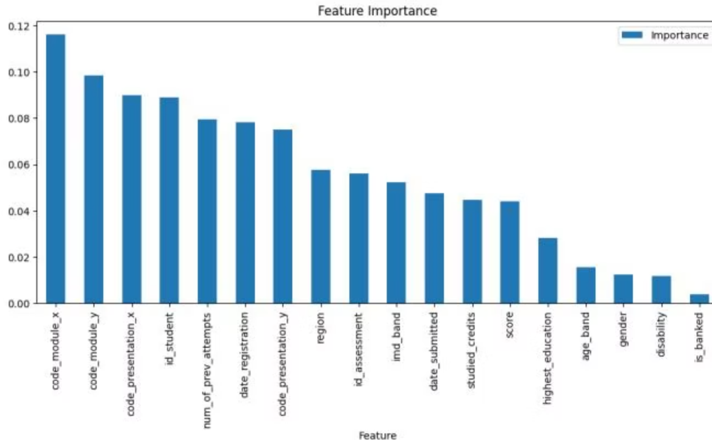
Feature Importance (Fig. 1)
Top predictors include prior education (highest_education), IMD band, and engagement measures. The chart orders features by importance, with module and presentation codes also prominent.

Slide 7
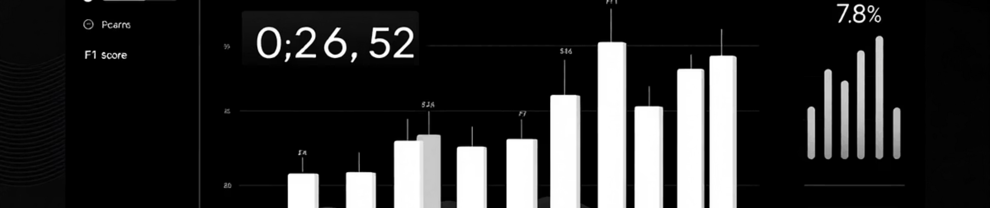
Model Evaluation & Results
Data Split
Metrics
Top Result
80% training, 20% testing with cross-validation across demographic subgroups.
Accuracy, precision, recall, F1 score, and confusion matrices used for evaluation.
Random Forest achieved 98.3% accuracy, outperforming Decision Tree (95.7%) and Gradient Boosting (88.5%).

Slide 8
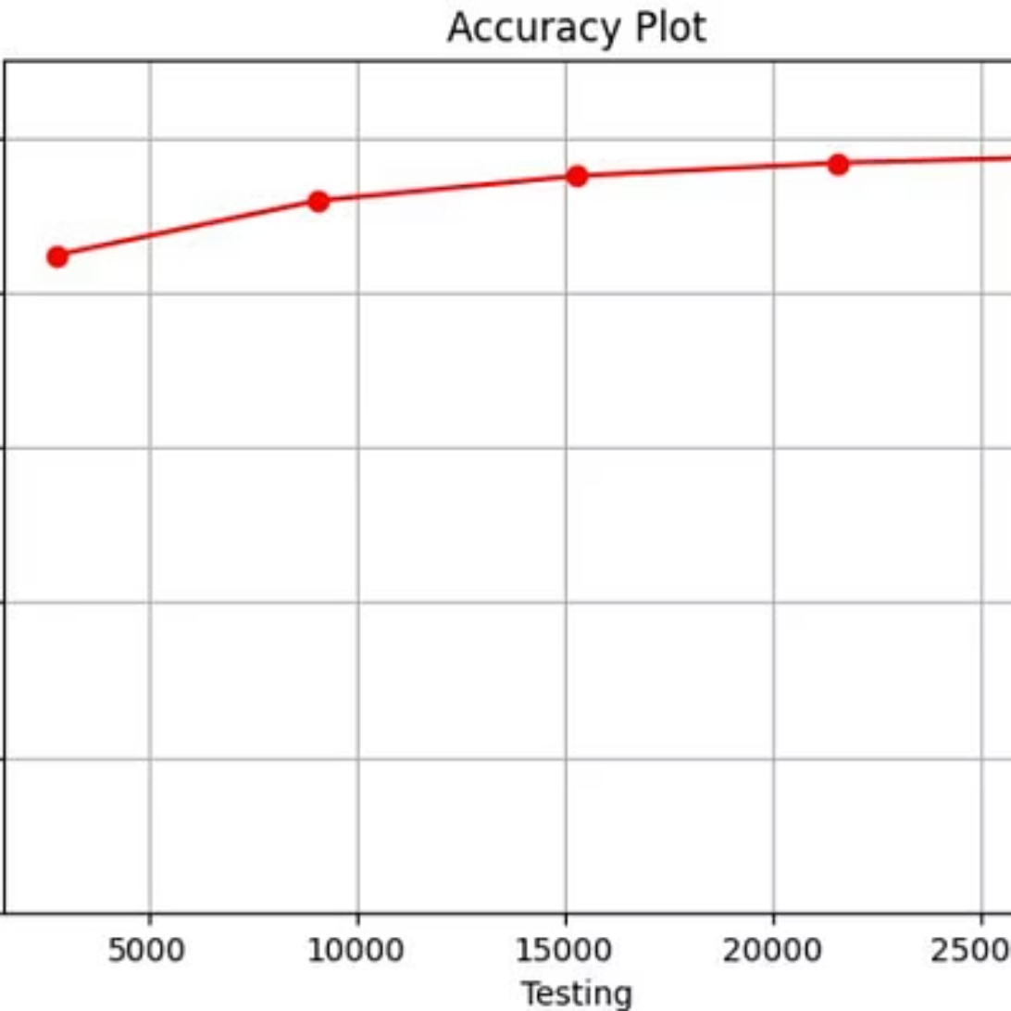
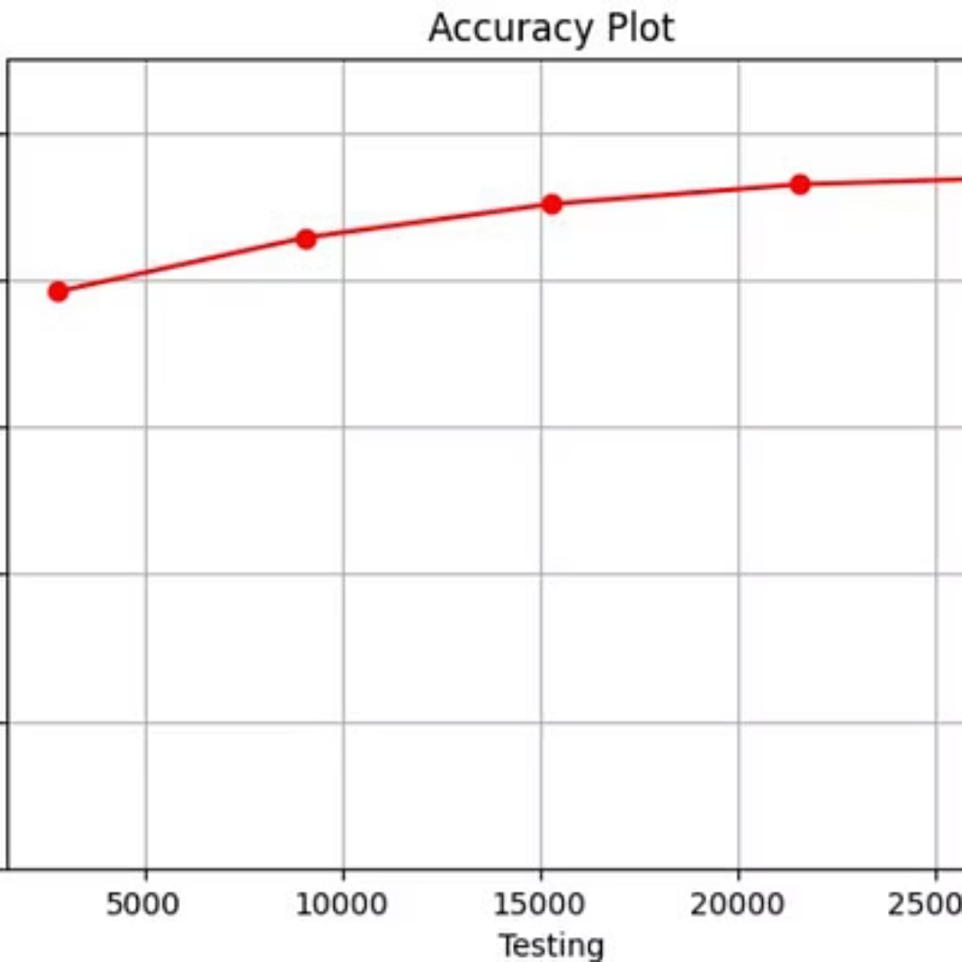
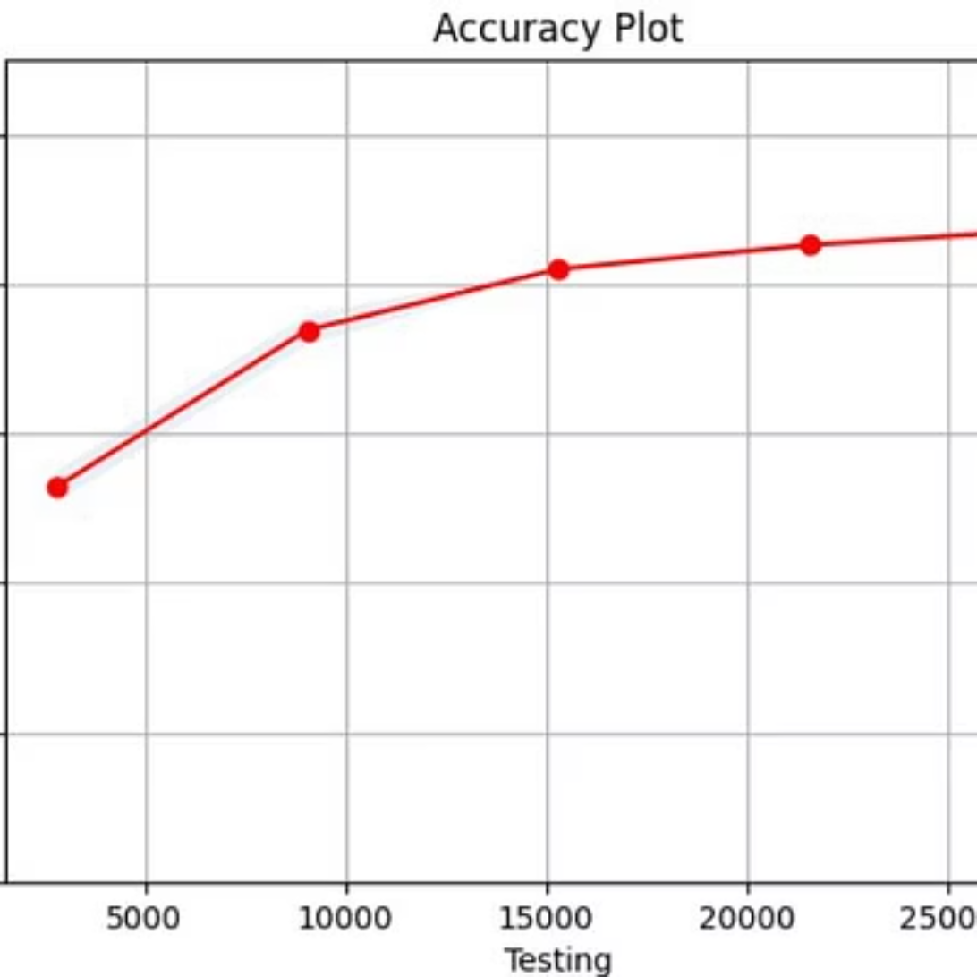
Performance Plots (Figs. 2–4)
All models show increasing accuracy with larger testing samples; Random Forest shows the highest and most stable accuracy curve.

Slide 9



Intervention Strategies & Implications
Early Identification
Personalized Plans
Detect at-risk students using demographic and engagement patterns.
Tailor learning paths and resources based on feature-driven risk signals.
Institutions can deploy data-driven early warning systems, allocate resources by need, and design adaptive interventions aligned with socioeconomic and prior-education profiles.

Slide 10

Conclusion & Future Work
Conclusion
Combining demographics, VLE engagement, and assessment data produced highly accurate, interpretable models. Random Forest reached 98.3% accuracy; prior education, IMD band, and engagement were key predictors.
Future Directions
Explore deep learning, implement XAI methods (SHAP/LIME), integrate broader datasets, and build real-time intervention systems to scale predictive support.

